Slide 1
Employee data analysis using excel
STUDENT NAME :LAVANYA V
REGISTER NO : 2213371036025
NM ID :unm410100442213371036025
DEPARTMENT : B COM (GEN)
COLLEGE : QUAID E MILLATH GOVERNMENT COLLEGE FOR WOMEN

Slide 2
PROJECT TITLE
EMPLOYEE PERFORMANCE ANALYSIS USING EXCEL

Slide 3
AGENDA
Problem statement
Project overview
End users
Our solution and proposition
Dataset description
Modelling aproach
Results and discussion
Conclusion

Slide 4
Problem statement
To analyze employee performance based on key performance indicators (KPIs), identifying patterns and areas for improvement, while taking into account factors such as productivity, efficiency, attendance, and task completion, in order to optimize overall organizational performance and decision-making."

Slide 5
Project overview
To analyse the performance based on some factors like Gender of the employee, performance of the employee , employee type etc., in order to findout the trendlines of medium and low employee performance

Slide 6
Who are the end users?
HR Managers: To evaluate employee performance, manage appraisals, and design improvement plans.
Team Leaders/Managers: To monitor team performance and provide feedback or support.
Executives: To make strategic decisions based on workforce efficiency and productivity.
Employees: To gain insights into their performance and identify areas for personal growth.
Analysts: To analyze performance data for trends and optimization opportunities.

Slide 7
Our solution and its value proposition
1. Identify areas of strength and weakness
2. Set performance goals and targets
3. Evaluate job performance and productivity
4. Develop training and development programs
5. Inform decisions on promotions, bonuses, and rewards
6. Improve communication and feedback
7. Increase employee motivation and engagement
8. Reduce turnover and absenteeism
9. Enhance overall organizational performance
10. Make data-driven decisions

Slide 8
Dataset description
Location code
Job function description
State
DOB
Division
Department type
Termination description
Ttermination type
Payzone
Start date
Exit date
Title
Supervisor
ADEmail
Empl I'd
First name
Last name
Business unit
Employee status
Employee type
Employee classification type
Gender code
Performance score
Crrent employee rating
Performance level
Martial desc
Race desc

Slide 9
The "wow"in our solution
Logical test:
=IFS(Z8>=5,"VERY HIGH",Z8>=4,"HIGH",Z8>=3,"MED",TRUE,"LOW"

Slide 10
modelling
Feature collection
1 . Collected overall features from employee dataset excel
2. Selected particular features
Data cleaning
1. Identified blank by applying conditional formating
2 . Removed blank by applying filter
Performance level
1. Calculated performance level by using the current employee rating
Summary
1 . prepared pivot table
2 . Filtered pivot table
Visualization
1. Prepared a graph using pivot table data
2 . prepared trendlines for medium and low performance

Slide 11
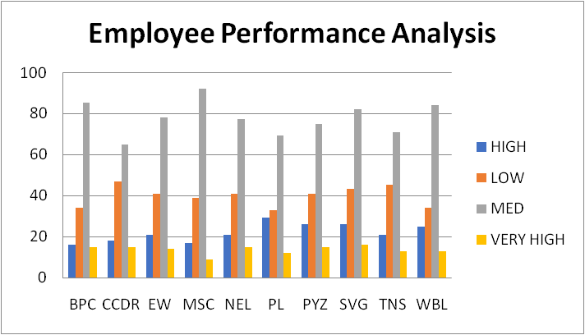
results

Slide 12
conclusion
In conclusion, employee performance analysis helps identify strengths, areas for improvement, and opportunities for growth. It enables better decision-making, increases productivity, and aligns individual goals with organizational objectives. Regular performance assessments foster a culture of continuous development and contribute to overall business success

